Slide 1



AI EDGE

Slide 2


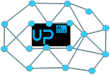
Centralized AI
=
Real Time
Decision
an the Edge

Slide 3





AI at the Edge
with CPUs + GPUs
=
Expensive Not Efficient (Gflops/W)

Slide 4
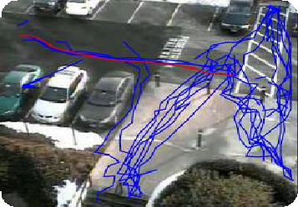
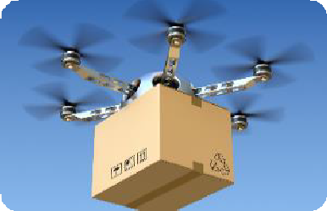


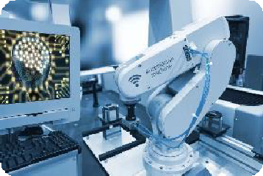



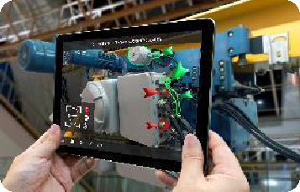



AI On The Edge for Robots, Drones, Portable/Mobile Devices Outdoor Devices
=
Efficient ( Gflops/W) Reasonable Cost Industrial Grade Archit.

Slide 5
AI Edge Use Case Video
Work Safety:
https://www.youtube.com/watch?v=-Wb_8VDGZD8&feature=youtu.be
Brand Recognition:
https://www.youtube.com/watch?v=so_3ki-Sc2U

Slide 6

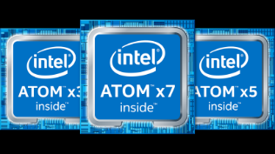
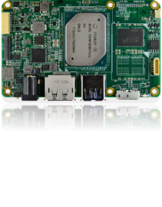



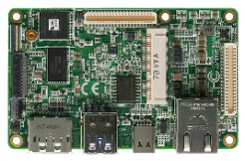
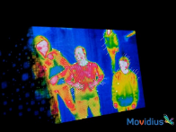
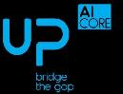
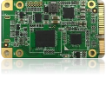
CREDIT SIZED STACKABLE ARTIFICIAL INTELLIGENCE PLATFORM FULLY POWERED by Intel® TECHNOLOGY
UP CORE PLUS
X86
AI PLUS
FPGA
AI CORE
VPU

Slide 7
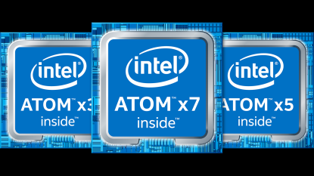

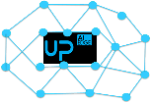
Intel® MOVIDIUS™
Myriad 2
Intel®
Atom x5/x7
Celeron/Pentium
+
+
Intel® Cyclone® 10 GX
Programmable
Versatile
Architecture
Super Rich I/O
Good for CPU Offload,
Real Time High Speed Signal Analysis
Low Power Consumption
Quad Core 64 bit x86 Architecture
OS agnostic
GPU integrated
Rich I/O
Video Processing Unit
(Hardware Neural Network)
Optimized for Machine Learning and Real Time
Pattern Recognition

Slide 8

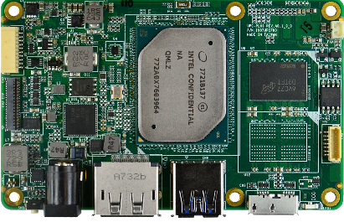
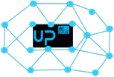
UP CORE PLUS
Credit Card Form Factor
Stackable & Expandable
Low Power Consumption
Cost Effective Solution
Low Power Consumption 6th Generation Atom, Celeron
Pentium Quad Core 64 bit x86 Architecture
GPU integrated
Intel Sensor HUB
Support of Windows 10, Linux Ubuntu, Yocto, Debian

Slide 9
UP CORE PLUS
Intel® Atom™ x5 / x7 / Celeron ®/ Pentium ®
2/4/8 GB DDRL 4 Dual Channel 2.400 MHz
32/64/128 GB eMMC
DP 4K@60 Hz
eDP
CSI 2 Lane + CSI 4 Lane
USB 3.0 Type A
USB 3.0 Type B
WiFi 802.11 AC 2T2R
2 x 100 pin expansion connector
Compatible with UP Core expansion board
12V DC In

Slide 10
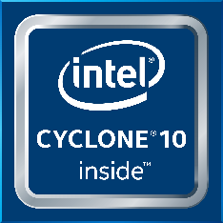

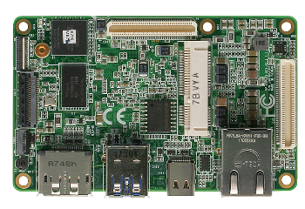
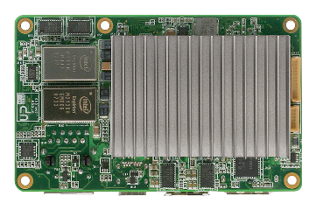

AI PLUS
Credit Card Expansion Board
Reach I/O
Low Power Consumption
Movidius via mPCIe
Programmable Versatile Architecture
Rich high speed I/O
Hardened Floating Point Capabilities
Good for CPU Off-loading
Real Time High Speed Signal Analysis
Support of Tensor Flow
Support of Quartus Design Tools, DSP Builder, and HLS Compiler
Compatible with Basler LVDS camera

Slide 11
AI PLUS
Intel Cyclone 10gx 105 / 150 / 220 Kle
Display Port IN connected to Cyclone
LVDS IN connected to Cyclone
USB 3.1 Device Type C connected to Cyclone
GPIO connected to Cyclone
USB 3.0 Type A connected to mainboard UP Core Plus
mPCI-Express connected to UP Core Plus
Gbit Ethernet connected to UP Core Plus

Slide 12
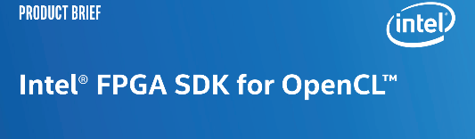
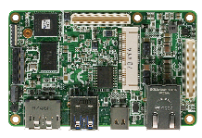

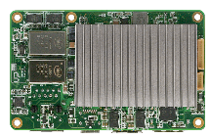
AI PLUS Target Customers
Software Developers
Purpose : Provide easy access to FPGA
Usage : Off load CPU via OpenCL™ and
machine vision via OpenCV
FPGA Developers
Purpose : Provide all-in-one versatile expandable industrial cost effective platform which integrates Intel® Atom™ x5/x7/Celeron ®/Pentium ® + Cyclone® 10 Gx
→ Usage : exploit complete FPGA for video acceleration, machine learning, algorithm acceleration

Slide 13

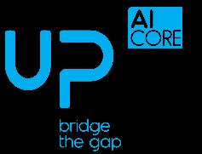
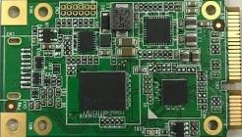
AI CORE
mPCIe expansion board
MOVIDIUS™ Myriad 2
Video Processing Unit
Optimized for Deep Learning
Ultra Low Power
Hardware Neural Network
Optimized for Machine Learning and Real Time
Pattern Recognition
Support of Tensor Flow & Caffe software
Compatible with all x86 computers with
mPCI-Express slot
Fully compatible with Intel Neural Compute Stick software suite

Slide 14

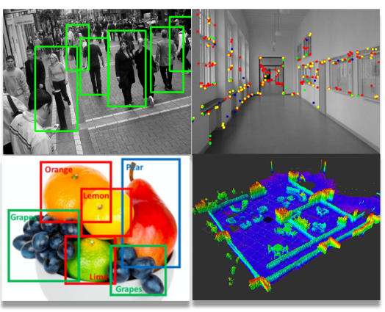
FEW EXAMPLES OF APPLICATIONS :
Object Recognition
People recognition

Slide 15

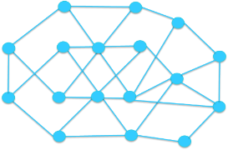
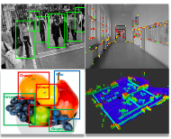
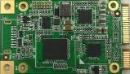
Create your model with Caffe or TensorFlow
Deploy it in the
Field on AI Core
Train Your Model
in the Cloud

Slide 16

Example :
Custom Solution with 5 Myriad 2 onboard
Performance = 5 x AI Core
= 5 x Myriad 2
Price = 3 x Price of AI Core
N x Myriad 2 = N x Performance < N x AI Core price

Slide 17
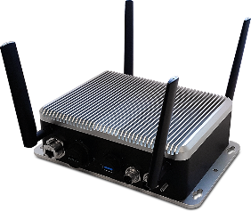
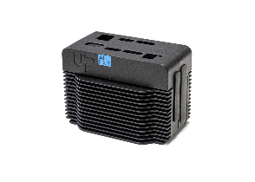
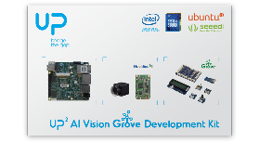
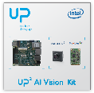
From development kit to field deployment
AI Edge
Outdoor
Gateway
AI Edge Indoor
Gateway
Development Kit
AAEON TECHNOLOGY EUROPE BV - Confidential

Slide 18


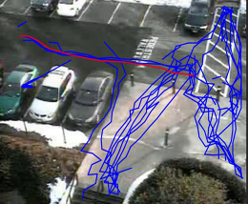
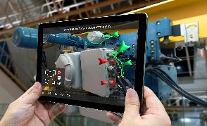

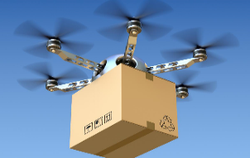
EXAMPLES OF TARGET APPLICATIONS
Predictive Maintenance
Machine Vision
Commercial Robot
Video Surveillance /
Traffic Control
Industrial
Augemted Reality
Intelligent Retail
Professional Air Drone

Slide 19
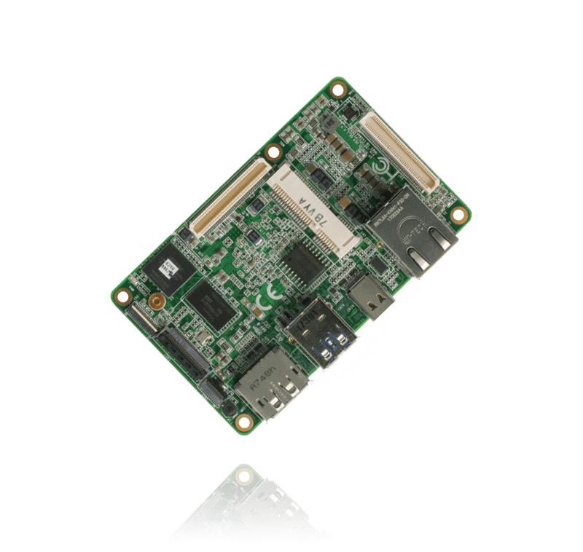
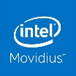
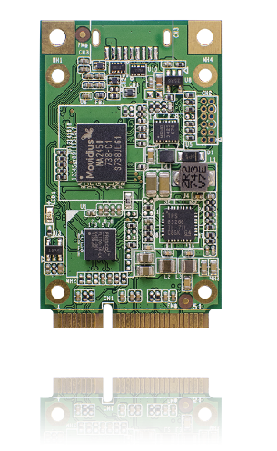
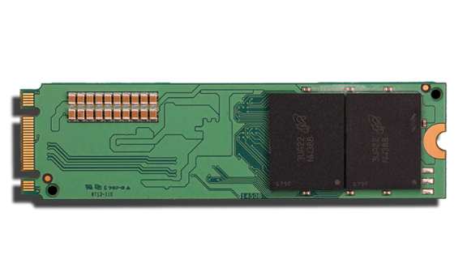
UP AI Vision Roadmap
Oct
Nov
Now
Dec
Vision Plus
-board to board connector
- Compatible for UP Core Plus ( Apollo Lake)
-4x Myriad 2
UP AI Core
-mini PCI-e
-1x Myriad 2
UP AI Core-X
-mini PCI-e
-1x Myriad X
UP AI Core-M
-M.2
-2x Myriad 2

Slide 20

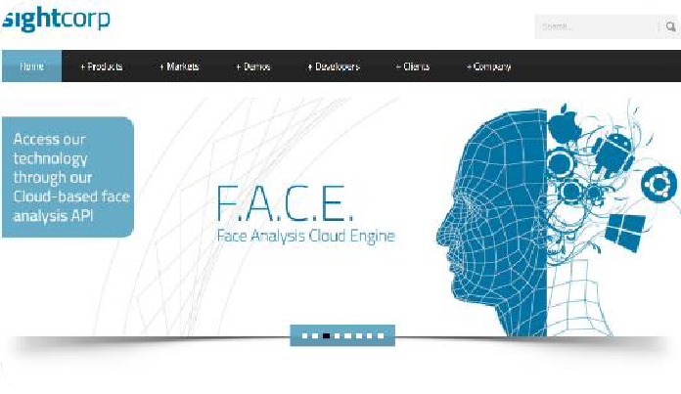

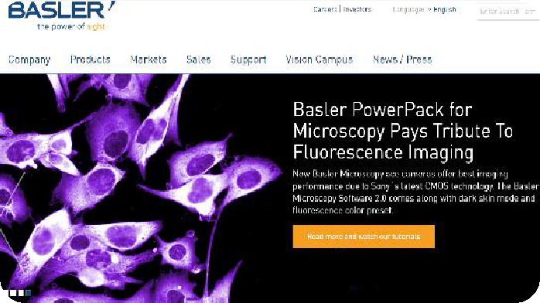





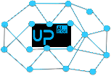
Join our A.I. Ecosystem

Slide 21
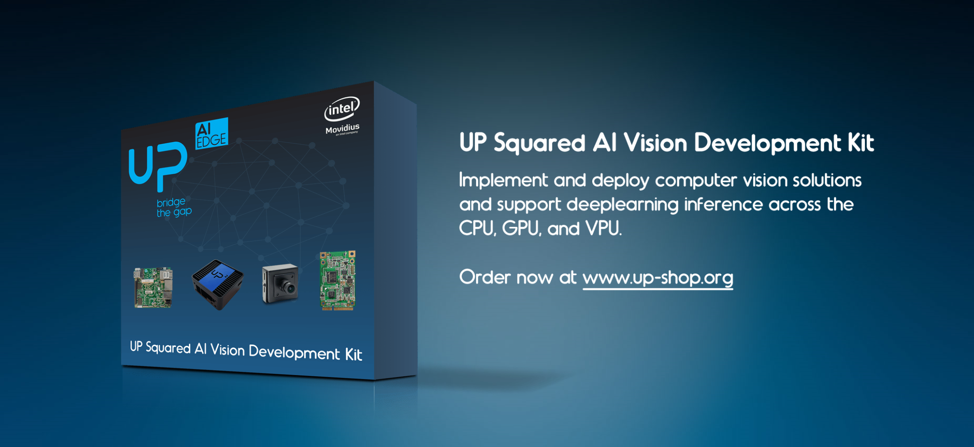
UP AI Vision Development Kits
Authorized OpenVINO™ Platform

Slide 22
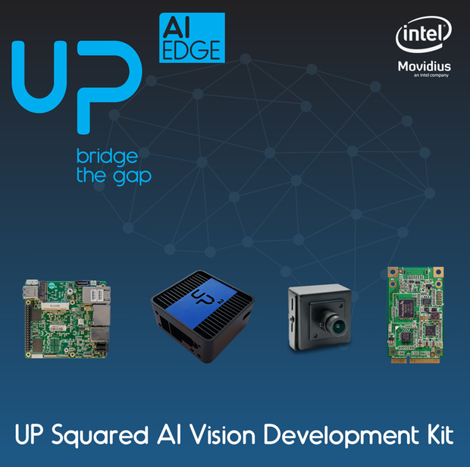
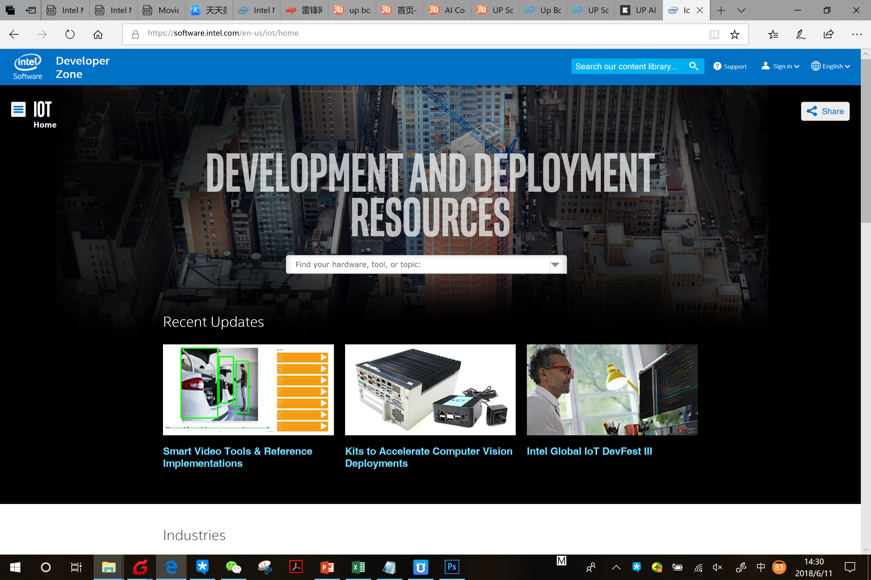
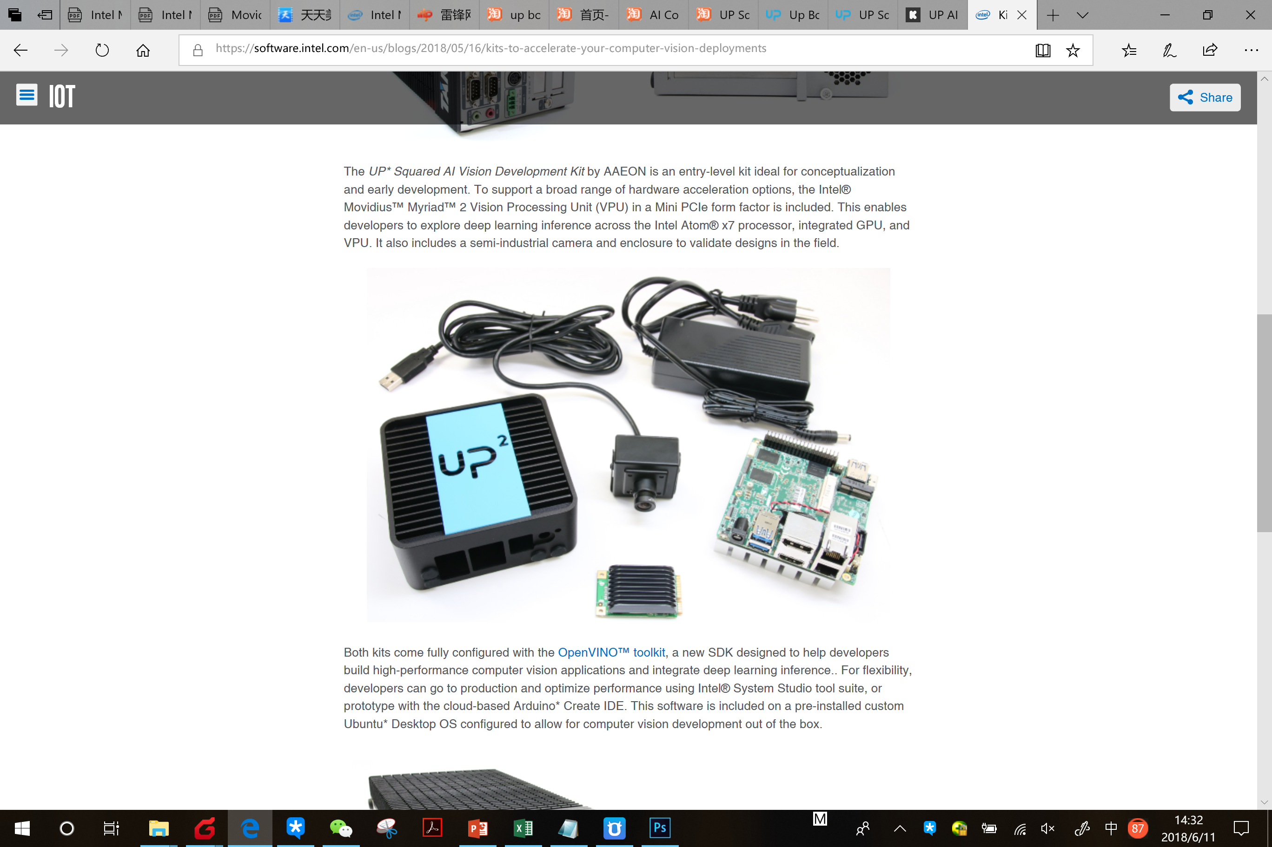
UP AI Vision Development Kits
UP Squared AI Vision Development Kit
UP Squared board (Atom™ X7-E3950, 4GB RAM / 64GB eMMC)
AI Core with Intel® Movidius™ Myriad™ 2 Vision processing Unit (VPU)
USB Camera with maximum resolution of 1920 x 1080p at 30 fps
Power supply 5V @ 6A
Fanless chassis

Slide 23
Intel Movidius Myriad VPU vs Nvidia GPU
Intel Movidius
Suitable for small PC even ARM PC
Low cost
Low power consumption
Require only mPCIe slot or M.2 slot
Does not require Internet connection as it is on the Edge
Myriad 2 = 100Gflops
Myriad X = 1Tflops
Nvidia GPU
Suitable for server and high end PC
High cost
High power consumption
Require PCIe slot
Require Internet connection if it is on server
Jetson TX1 = 1Tflops
Jetson TX2 = 2Tflops

Slide 24

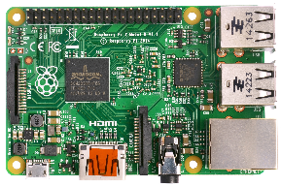


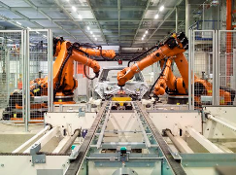
The Idea
+
=
The Most Popular platform
for prototypes
The Most Scalable Technology
+
Industrial Grade Electronic
Manufacturing Process and Components

Slide 25
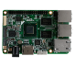
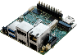
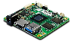












UP Series
UP Board Series
UP AI Edge
UP Boards
Main Boards
UP Core Plus
UP
UP Squared
UP core
UP HATs
AI Accelerator
AI Core
UP Kits
FPGA
AI Plus
UP System
Expansion
Net Plus

Slide 26

UP Squared Grove IoT Development Kit

Slide 27


UP Squared Grove IoT Development Kit
List of Content:
UP Squared Intel Celeron N3350, 2GB DDR4, 32GB eMMC
Power Supply
Grove Adapter
Grove Sensors (LCD RGB Backlight, - Rotary Angle Sensor, Light Sensor v1.2, Button, Temperature & Humidity Sensor)
16GB USB drive
USB3.0 OTG cable
Pre-loaded OS and supported by Arduino Create
Product page:
https://software.intel.com/en-us/iot/hardware/up-squared-grove-dev-kit

Slide 28

Arduino Create & UPM

Slide 29





Expand it
Mobile power HAT
- 40-pin
- Power by battery pack
Anybus Common Ethernet Slave
- mPCIe
- Automation protocol
Power over Ethernet
- 40-pin
- Power over LAN
eDP adapter
- Convert LVDS to eDP
Fanless metal chassis & DIN RAIL kit
Audio HAT
- 40-PIN
- Line-out,MIC,buzzer

Slide 30


Slide 31














Industrial Eco-System

Slide 32


The "Android" name and the Android logo are property of Google Inc.
Microsoft and Windows are either registered trademarks or trademarks of Microsoft Corporation in the United States and/or other countries.
Intel, the Intel logo, Intel Insider, Intel SpeedStep, and Atom are trademarks of Intel Corporation in the U.S. and/or other countries. All rights reserved.
UP Bridge The Gap is Trademark of Aaeon Europe. All Rights reserved.

